Slide 1
A Brief Intro to Visual Prompting
Haoquan Zhang 张皓泉

Slide 2
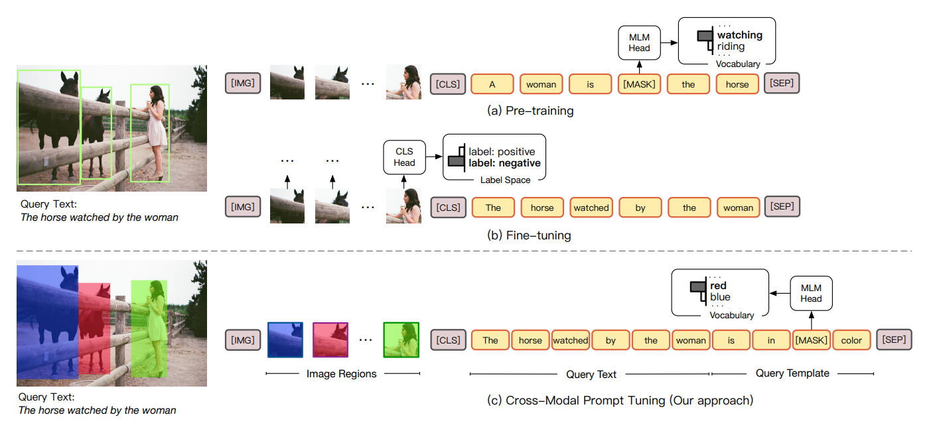
CPT: Colorful Prompt Tuning for Pre-trained Vision-Language Models
https://arxiv.org/pdf/2109.11797

Slide 3
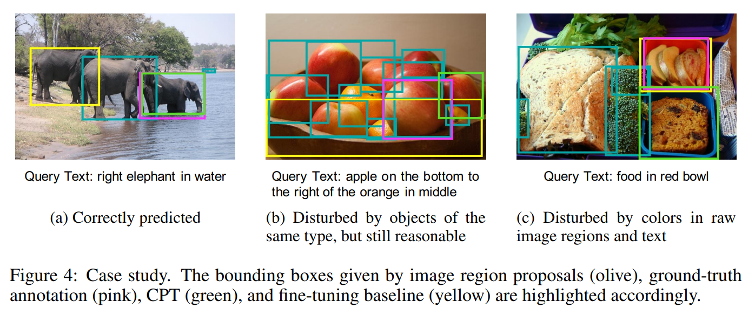
CPT: Colorful Prompt Tuning for Pre-trained Vision-Language Models
https://arxiv.org/pdf/2109.11797

Slide 4
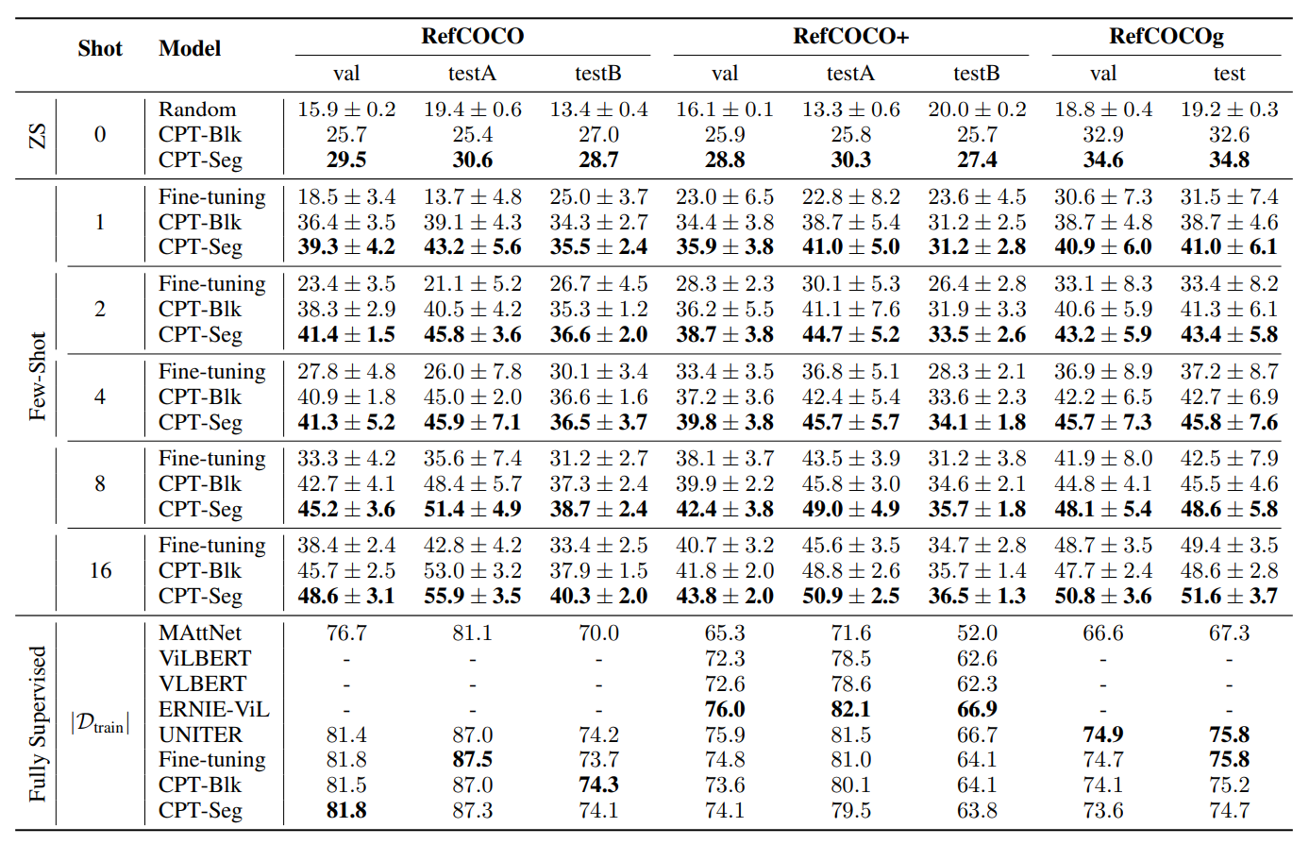
CPT: Colorful Prompt Tuning for Pre-trained Vision-Language Models
https://arxiv.org/pdf/2109.11797

Slide 5
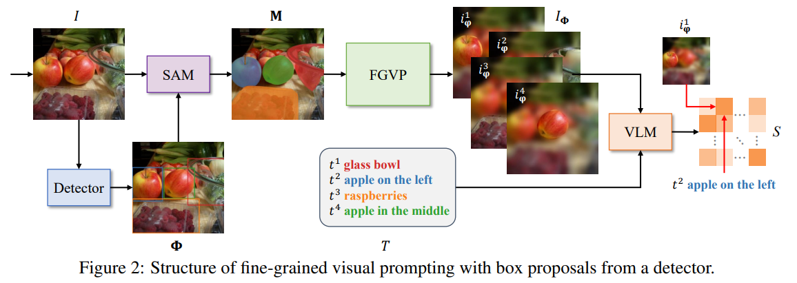
Fine-Grained Visual Prompting
https://arxiv.org/pdf/2306.04356

Slide 6
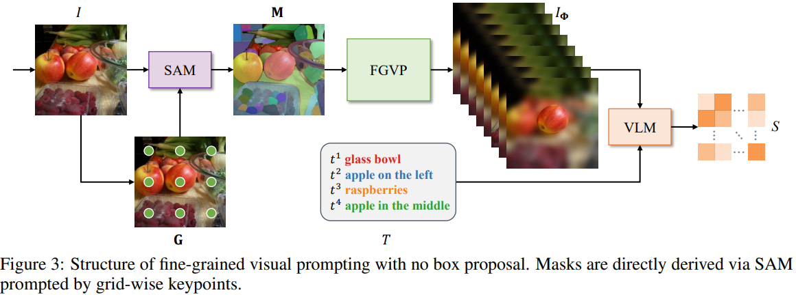
Fine-Grained Visual Prompting
https://arxiv.org/pdf/2306.04356

Slide 7
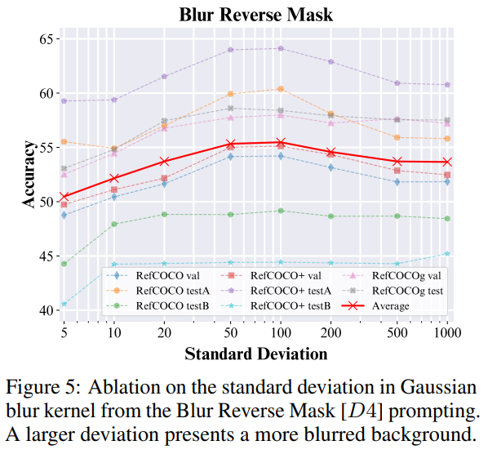
Fine-Grained Visual Prompting
https://arxiv.org/pdf/2306.04356

Slide 8
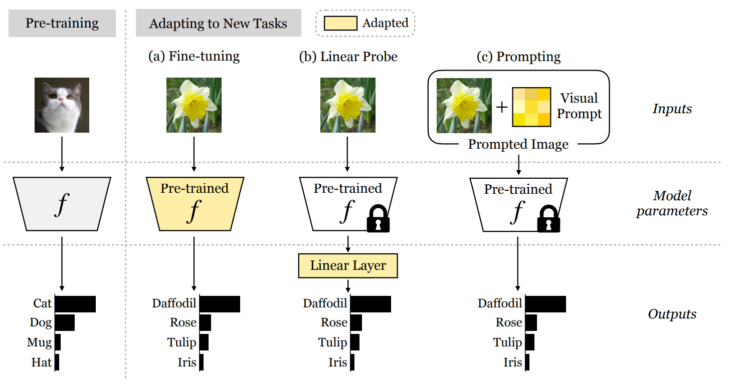
Exploring Visual Prompts for Adapting Large-Scale Models
https://arxiv.org/pdf/2203.17274

Slide 9
What is Visual Prompt? How does it work?
https://arxiv.org/pdf/2203.17274

Slide 10
What is Visual Prompt? How does it work?
https://arxiv.org/pdf/2203.17274

Slide 11
What is Visual Prompt? How does it work?
https://arxiv.org/pdf/2203.17274

Slide 12
What is Visual Prompt? How does it work?
https://arxiv.org/pdf/2203.17274

Slide 13
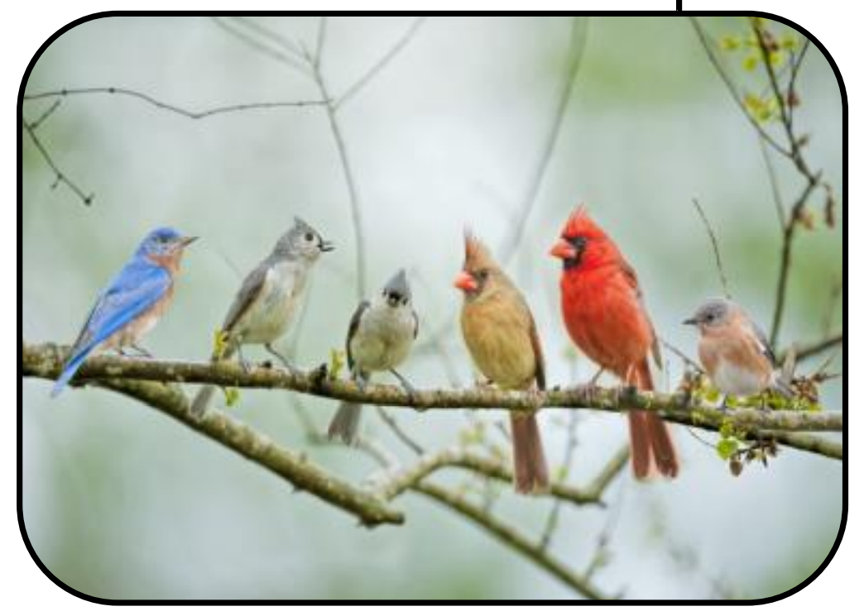
Attention Prompting on Image for Large Vision-Language Models
Which direction is the red bird facing?
https://arxiv.org/pdf/2409.17143

Slide 14
Attention Prompting on Image for Large Vision-Language Models
https://arxiv.org/pdf/2409.17143

Slide 15
Attention Prompting on Image for Large Vision-Language Models
https://arxiv.org/pdf/2409.17143

Slide 16
Attention Prompting on Image for Large Vision-Language Models
https://arxiv.org/pdf/2409.17143

Slide 17
Summary Visual Prompting

Slide 18
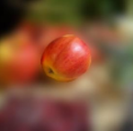
Bbox Mask
Blur
Pixel Prompt
Attention

Slide 19
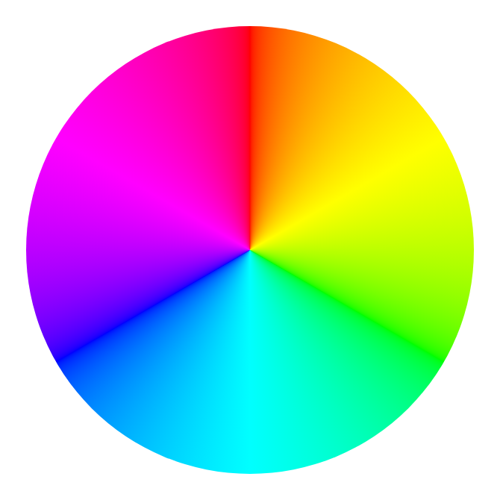
X
Bbox Mask
Color

Slide 20
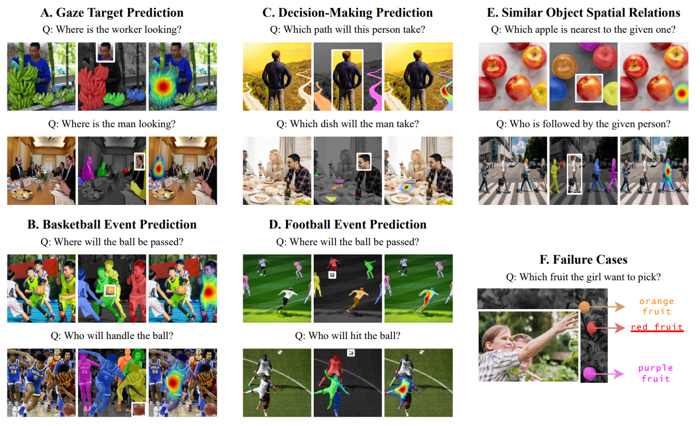
Haoquan Zhang et.al, Mask4Align, CVPR2024

